Slide 1
UCB - CS189 Introduction to Machine Learning Fall 2015 Lecture 11: Embedded methods for model and feature selection
Isabelle Guyon
ChaLearn

Slide 2

Come to my office hours… Wed 2:30-4:30 Soda 329
Last time: model search

Slide 3
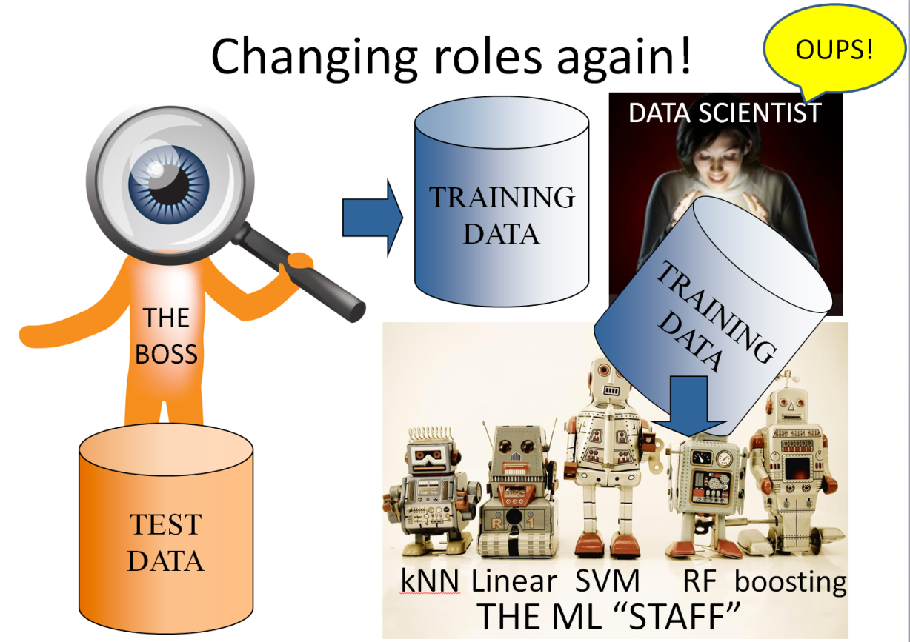
Come to my office hours… Wed 2:30-4:30 Soda 329
Today

Slide 4
Remember: The DREAM
AutoML
black box
Trained
model
TRAINING
DATA
Answer y
?
Query x

Slide 5

Remember: The REALITY
Hyper-parameter tuning
Trained
model
TRAINING
DATA
Answer y
?
Query x
http://codalab.org/AutoML
5

Slide 6


Last time you were the data scientist
TRAINING
DATA
DATA SCIENTIST
Validation
set
THE
BOSS
Training
set
TEST
DATA
kNN Linear SVM RF boosting
THE ML “STAFF”

Slide 7
Changing roles again!
OUPS!
TRAINING
DATA
DATA SCIENTIST
TRAINING
DATA
THE
BOSS
TEST
DATA
kNN Linear SVM RF boosting
THE ML “STAFF”

Slide 8

Remember your options
Reduce the number of hyper-parameters.
Learn how to do “fancy” search.

Slide 9
Remember your options
Reduce the number of hyper-parameters.
Learn how to do “fancy” search.
Push more hyper-parameters to the “lower level”.

Slide 10
Embedded methods

Slide 11
Why do we need HP?
Could we not just optimize the parameters and hyper-parameters together with the training error?
No, because:
Computational complexity: we loose convexity in parameter space.
Statistical complexity: we get infinite (or zero) capacity.

Slide 12
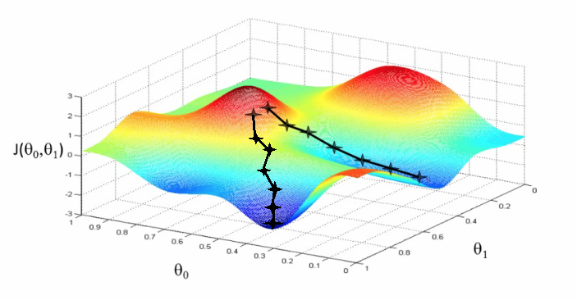
Gradient descent falls into local minima…
Complexity:
computational
R[w1, w2]
w2
w1
is the learning rate of gradient step.

Slide 13
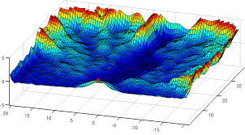
… finding the global optimum can be hard …
Complexity:
computational
R[w1, w2]
w2
w1

Slide 14
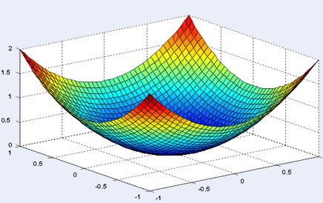
… except if the risk functional is convex!
Complexity:
computational
R[w1, w2]
w1
w2
Convexity: Hessian matrix is positive semidefinite.

Slide 15
Convexity
Complexity:
computational
R = RSS = Σ_{k} (x^{k} w^{T} –y^{k})²
= ǁ Xw^{T} –y ǁ²
= wX^{T}Xw^{T} –2wX^{T}y +y^{T}y
Gradient:
∇_{w}R = 2 (X^{T}Xw^{T} – X^{T}y)
Hessian:
H(R) = 2 X^{T}X
X^{T}X is an outer product, therefore it is PSD.

Slide 16
Kernel trick
Complexity:
computational
Hessian:
H(R) = 2 X^{T}X
In Φ-space:
H(R) = 2 Φ^{T}Φ
= 2 K
This is why it is useful that the kernel matrix K be PSD.

Slide 17
SVM in α space
Complexity:
computational
f(x) = Σ_{k} α_{k} k(x^{k}, x) K = [k(x^{k}, x^{h})]
Hinge loss version:
min_{α} α^{T} y - (1/2) α^{T} K α
0 ≤ α_{k} y_{k} ≤ 1/λ box constraint
α^{T} 1 = 0 bias constraint
2) Square hinge loss version
min_{α} α^{T} y - (1/2) α^{T}(K + λΙ)α
α_{k} y_{k} ≥ 0
α^{T} 1 = 0 bias constraint
Decision boundary
Margin
hinge loss max(0, 1-z)
1
ridge
square hinge loss max(0, (1- z)²)
0
missclassified
1
well classified
http://homepages.rpi.edu/~bennek/class/mmld/papers/svn.pdf
http://cs229.stanford.edu/notes/cs229-notes3.pdf

Slide 18
Loosing convexity
Complexity:
computational
R[α, θ] = α^{T} y - (1/2) α^{T} K(θ) α
K(θ) = [ k(x^{k}, x^{h}; θ) ]_{k=1:N, h=1:N}
k(x, x’; θ) = (a + x . x’)^{b} exp(- c ǁx - x’ǁ^{d} )
θ = [a, b, c, d]

Slide 19
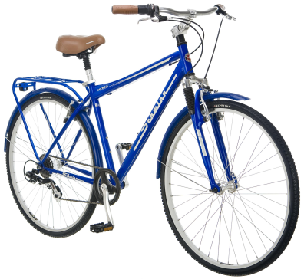

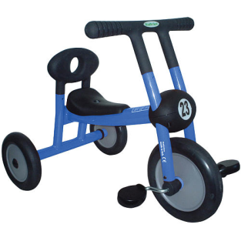

Avoid overfitting… f(x) = ( Σ_{k} α_{k} [Φ(x^{k}) ) • Φ(x) ]
Complexity:
Statistical
w
k(x^{k}, x; θ)
Parzen windows
α_{k =} y_{k}
Any k(x^{k}, x; θ)
θ fitted to R_{CV}
f(x)=Σ_{k} α_{k} k(x^{k}, x ; θ)
Perceptrons
α_{k} fitted to R_{train}
k(x^{k}, x) = x^{k} • x
No θ
f(x) = w • x
Kernel methods
α_{k} fitted to R_{train}
Any k(x^{k}, x; θ)
θ fitted to R_{CV}
f(x)=Σ_{k} α_{k} k(x^{k}, x ; θ)
Hebb’s method
α_{k =} y_{k}
k(x^{k}, x) = x^{k} • x
No θ
f(x) = w • x

Slide 20
Nested subsets
Complexity:
Statistical
Capacity /complexity
Perceptrons
α_{k} fitted to R_{train}
k(x^{k}, x) = x^{k} • x
No θ
f(x) = w • x
Kernel methods
α_{k} fitted to R_{train}
Any k(x^{k}, x; θ)
θ fitted to R_{CV}
f(x)=Σ_{k} α_{k} k(x^{k}, x ; θ)
Hebb’s method
α_{k =} y_{k}
k(x^{k}, x) = x^{k} • x
No θ
f(x) = w • x

Slide 21
Nested subsets
Complexity:
Statistical
Capacity /complexity
Parzen windows
α_{k =} y_{k}
Any k(x^{k}, x; θ)
θ fitted to R_{CV}
f(x)=Σ_{k} α_{k} k(x^{k}, x ; θ)
Kernel methods
α_{k} fitted to R_{train}
Any k(x^{k}, x; θ)
θ fitted to R_{CV}
f(x)=Σ_{k} α_{k} k(x^{k}, x ; θ)
Hebb’s method
α_{k =} y_{k}
k(x^{k}, x) = x^{k} • x
No θ
f(x) = w • x

Slide 22
Guaranteed risk to avoid overfitting
Complexity:
Statistical
With high probability (1-δ),
0<δ<<1
R[f] ≤ R_{train}[f] + ε(δ, C/N)
R_{gua}[f]
Ga, Guaranteed risk
Ga= Tr + ε(C/N)
ε, Function of Model Complexity C
Tr, Training error
Complexity/Capacity C

Slide 23




Shrinkage: min_{w} R_{train}[w] + λ ǁwǁ²
Complexity:
Statistical
Capacity = d_{effective}
Perceptrons
f(x) = w • x

Slide 24



Shrinkage: min_{w} R_{train}[w] + λ ǁwǁ²
Complexity:
Statistical
Capacity = d_{effective}
Kernel methods
f(x)=Σ_{k} α_{k} k(x^{k}, x ; θ)
ǁwǁ² = ww^{T}
= α^{T}ΦΦ^{T} α
= α^{T}Κ α

Slide 25
Statistical domains
Complexity:
Statistical
Market
Analysis
10⁶
Ecology
Computer
Vision
N training examples
OCR
HWR
10⁵
Non linear kernel methods
Text
Categorization
10⁴
10³
Linear model with Hebb’s rule
Regularized linear models
with hinge/logistic/least-square
System diagnosis
10²
Bioinformatics
10
d inputs
10
10²
10³
10⁴
10⁵
10⁶

Slide 26

What you want:
Complexity:
Statistical
Keep C/N (or d_{eff}/N) under control

Slide 27
Guaranteed risk to avoid overfitting
Complexity:
Statistical
With high probability (1-δ),
0<δ<<1
R[f] ≤ R_{train}[f] + ε(δ, C/N)
R_{gua}[f]
Ga, Guaranteed risk
Ga= Tr + ε(C/N)
ε, Function of Model Complexity C
Tr, Training error
Complexity/Capacity C

Slide 28

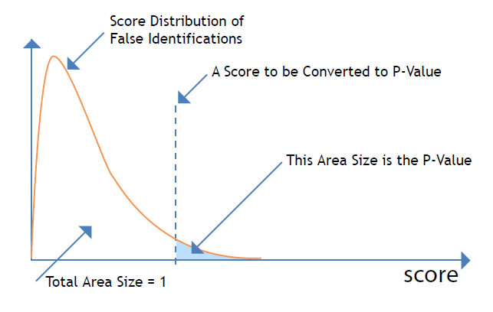
The intuition: remember pvalues
Complexity:
Statistical
Your score distribution
Reference score
Total area size = 1
Pvalue = fraction of score values above the reference score.
SMALL pvalues are good: they shed doubt on the “null hypothesis”.

Slide 29
Guaranteed risk and pvalue
Complexity:
Statistical
Your score distribution:
R[f]-R_{train}[f]
Reference score:
ε(δ, C/N)
With high probability (1-δ)
0<δ<<1
R[f] ≤ R_{train}[f] + ε(δ, C/N)
: δ
R_{gua}[f]
Total area size = 1
Pvalue = fraction of score values above the reference score.
SMALL pvalues are good: they shed doubt on the “null hypothesis”.

Slide 30
Test set bounds
Complexity:
Statistical
Your score distribution:
R[f]-R_{test}[f]
Reference score:
ε(δ, 1/n)
With high probability (1-δ)
0<δ<<1
R[f] ≤ R_{test}[f] + ε(δ, 1/n)
For instance, R_{test} = E
ε(δ, 1/n) ∼ √E(1-E)/n
: δ
Total area size = 1
Pvalue = fraction of score values above the reference score.
SMALL pvalues are good: they shed doubt on the “null hypothesis”.

Slide 31
Multiple testing Bonferroni’s correction: pvalue * m
Complexity:
Statistical
Your score distribution:
R[f]-R_{test}[f]
Reference score:
ε(δ, 1/n)
The area is now (1-δ)^{m}
0<δ<<1
R[f] ≤ R_{test}[f] + ε(δ, 1/n)
: ~mδ
Total area size = 1
Pvalue = fraction of score values above the reference score.
SMALL pvalues are good: they shed doubt on the “null hypothesis”.

Slide 32
Multiple testing Variable change
Complexity:
Statistical
Your score distribution:
R[f]-R_{test}[f]
Reference score:
ε(η/m, 1/n)
The area is now (1-η)
0<η<<1
R[f] ≤ R_{test}[f] + ε(η/m, 1/n)
: ~η
Total area size = 1
Pvalue = fraction of score values above the reference score.
SMALL pvalues are good: they shed doubt on the “null hypothesis”.

Slide 33
In fact… log(m) is a complexity/capacity
Complexity:
Statistical
Vapnik 1974
Your score distribution:
R[f]-R_{test}[f]
Reference score:
ε(η/m, 1/n)
The area is now (1-η)
0<η<<1
R[f] ≤ R_{test}[f] + ε(η/m, 1/n)
: ~η
Total area size = 1
ε(η/m, 1/n) = sqrt(log(2m/η)/2n)

Slide 34
In fact… log(m) is a complexity/capacity
Complexity:
Statistical
Vapnik 1974
Your score distribution:
R[f]-R_{test}[f]
Reference score:
ε(η/m, log(m)/n)
The area is now (1-η)
0<η<<1
R[f]≤R_{test}[f]+ε(η/m, log(m)/n)
: ~η
Total area size = 1
ε(η/m, 1/n) = sqrt(log(2m/η)/2n)

Slide 35
Capacity for “multiple testing”
Complexity:
Statistical
Vapnik 1974
The “test” set became a training set!!!!
With high probability (1-δ),
0<δ<<1
R[f] ≤ R_{test}[f]+ ε(δ, log(m)/N)
R_{gua}[f]
C
Ga, Guaranteed risk
Ga= Te+ ε(log(m)/n)
ε, Function of Model Complexity C
Tte Test error
Complexity/Capacity C

Slide 36
Capacity
Complexity:
Statistical
Vapnik-Chervonenkis 1971
C = log(m) is the capacity for a FINITE number of hypotheses (m is number of models tried).
What is C for a continuous hypothesis space (parameterized with w, α, q, σ, etc.?)

Slide 37
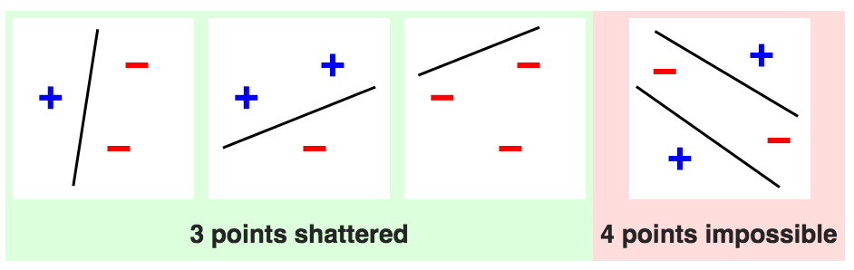
VC dimension
Complexity:
Statistical
Vapnik-Chervonenkis 1971
C = number of training examples that can be separated, regardless of the assignment of labels.
Source: Wikipedia
For f(x) = w.x (linear decision boundary/hyperplane)
the VC dimension is C = d (the dimension of input space).

Slide 38
VC dimension of Perceptrons and kernel methods
Complexity:
Statistical
f(x) = w • Φ(x), the VC dimension is D
(the dimension of FEATURE space).
w = Σ_{k} α_{k} Φ(x^{k}) → kernel trick
f(x) = Σ_{k} α_{k} Φ(x^{k}) • Φ(x)= Σ_{k} α_{k} k(x^{k}, x)
k(x^{k}, x) = Φ(x^{k}) • Φ(x)
If D is infinite, the VC dimension is infinite!

Slide 39
VC dimension of kernel methods
Complexity:
Statistical
Not quite that bad…
Remember the representer theorem:
f*(x) = argmin_{f} R_{train}[f] + λΩ[f] admits a representation
f*(x) = Σ_{k} α_{k} k(x, x^{k})
We can consider that k(., x^{k}) are features Φ(.) of a Perceptron with N parameters (the α_{k}). So:
C ≤ N.
For support vector machines the sum runs only over the N_{S} support vectors, so:
C ≤ N_{S}.

Slide 40
Complexity:
Statistical
SVM leave-one-out error:
Bounded by N_{SV}/N
x₂
f(x) > 0
f(x) = 0
x = [x₁, x₂]
f(x) < 0
x₁
f(x) = Σ_{k} α_{k} k(x_{k}, x) + b
SVM, Boser-Guyon-Vapnik, 1992

Slide 41
But… the kernels have HP
Complexity:
Statistical
f(x) = Σ_{k} α_{k} k(x, x^{k}; θ)
They are IN FACT universal approximators:
C = ∞
if we also optimize θ with the training set.
So we need to FIX θ to enjoy a finite C when we use the training set. We can then find the best θ with a validation set (a second level learning problem).

Slide 42
For λ we also need 2 levels
Complexity:
Statistical
min_{f} R_{reg}[f]
R_{reg}[f] = R_{train}[f] + λ ǁ w ǁ²
∂R_{reg}/∂λ = ǁ w ǁ²
At the optimum, ǁ w ǁ² = 0. Not very helpful: C = 0
if we also optimize λ with the training set.
So we need to FIX λ TOO to enjoy a finite C when we use the training set. We can then find the best λ with a validation set (another second level learning problem).

Slide 43
Summary (so far)
Heuristic HP search (wrapper-style) is computationally expensive, so we want to “push down” some HP to the learning machine.
But optimizing both parameters and HP with the training error is not a good idea because of:
Computational complexity: we loose convexity in parameter space.
Statistical complexity: to train we get need finite capacity 0<C<∞.
Embedded methods solve a bi-level optimization problem by direct optimization of the HP by cross-validation using knowledge about the learning machine to conduct a more efficient search. But how? Grid search => K * g^{d} learning machine to train. K=number of folds in K-fold, g = number of grid points, d the number of hyper-parameters.
Idea #1: Approximate the leave-one-out error by “sensitivity analysis” to get a cheap R_{CV}. Gain: replace K-fold by training ONCE.
Idea #2: Diagonalise X^{T}X or XX^{T} (or the kernel matrix): makes inversion “cheap” by varying λ. Gain: replace training g machines by ONE.

Slide 44
Idea #1: Virtual leave-one-out
Support Vector Machines:
Refinements of N_{SV}/N.
Linear regression:
r_{LOO}^{k} = r_{TRAIN}^{k} / (1 - [XX⁺]_{kk})
Kernel methods including SVM, regression, logistic regression:
Efficient approximate leave-one-out cross-validation for kernel logistic regression (Cawley-Talbot, 2008)
Neural Networks:
Local Linear Least Squares: Performing Leave-one-out Without Leaving Anything Out (Monari-Dreyfus, 2002)

Slide 45
Example 1: SVM (hard margin)
- LOO functional margin
ψ
R_{LOO} = (1/N) Σ_{k=1:N} ψ(-y_{k}f^{(-k)}(x^{k}))
R_{LOO} ≤ (1/N) Σ_{k∈{SV}} ψ(U^{k} -1)
1
0
0
U^{k} is a bound on the change in functional margin for SV
0 ≤ y_{k}f⁽⁰⁾(x^{k}) - y_{k}f^{(-k)}(x^{k}) ≤ U^{k}
Simplest bound U^{k} = ∞ ⇒ R_{LOO} = N_{SV}/N.
Jaakkola-Haussler (1999): U^{k} = α_{k} k(x^{k}, x^{k})
Opper-Winther (2000): U^{k} = α_{k} / [K_{SV}⁻¹]_{kk}
Span bound Vapnik-Chapelle (2000): U^{k} = α_{k} S_{k}²
where S_{k} is the distance of φ(x^{k}) to the span of other SV.

Slide 46
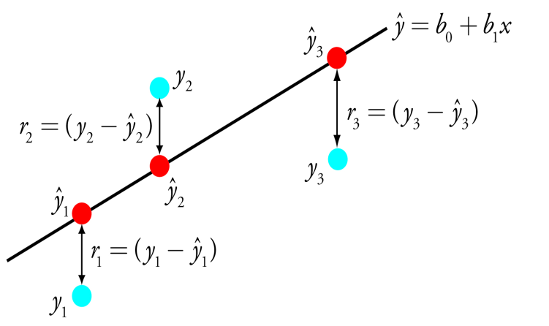
Example 2:
Linear regression
R_{LOO} = (1/N) Σ_{k=1:N} (r_{LOO}^{k})² MSE
r_{LOO}^{k} = y_{k}- f^{(-k)}(x^{k}) residual of example k for f^{(-k)}
r_{TRAIN}^{k} = y_{k}- f(x^{k}) residual of example k for f
Efron-Tibshirani, 1993
r_{LOO}^{k} = r_{TRAIN}^{k} / (1 - [XX⁺]_{kk})

Slide 47
Idea #2: Matrix factorization
We need to compute: (XX^{T} + λ I)⁻¹ or (X^{T}X + λ I)⁻¹, whichever is smallest: dim (N,N) or (d,d).
So (K + λ I)⁻¹ in general.
We want to factorize a symmetric matrix K as:
K = U^{T}DU, where D is a diagonal matrix
(of eigenvalues) and U is an orthogonal matrix
of eigenvectors: U^{T}U = I (and U^{T}(λ I)U = λ I)
Then (K + λ I)⁻¹ = (U^{T}DU + U^{T}(λ I)U) ⁻¹
= (U^{T}(D+λ I)U)⁻¹
(K + λ I)⁻¹ = U(D+λ I)⁻¹U^{T}

Slide 48
How does this relate to dimensionality reduction?
Reminder: For f(x) = w.x the VC dimension is C = d (the dimension of input space).
R_{reg} = R_{train} + λ ǁ w ǁ²
w₂
w₁

Slide 49
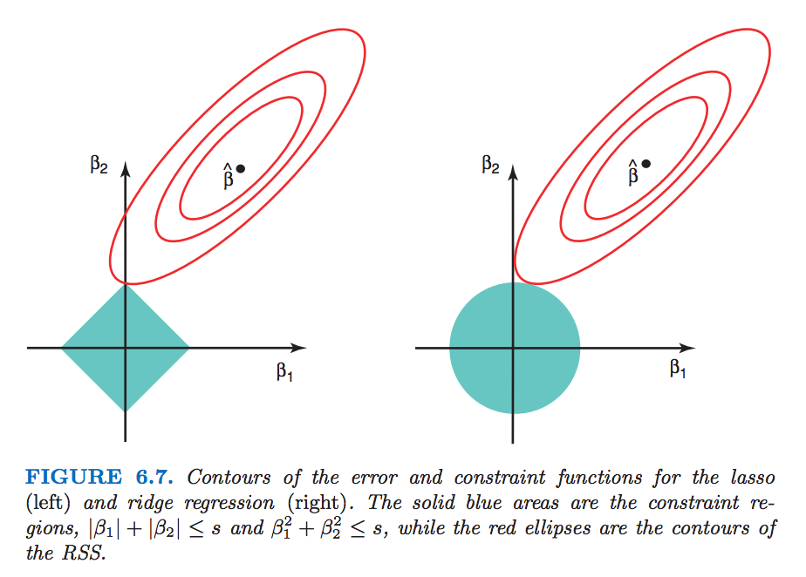
Different regularizers
Source: ISLR http://www-bcf.usc.edu/~gareth/ISL/

Slide 50
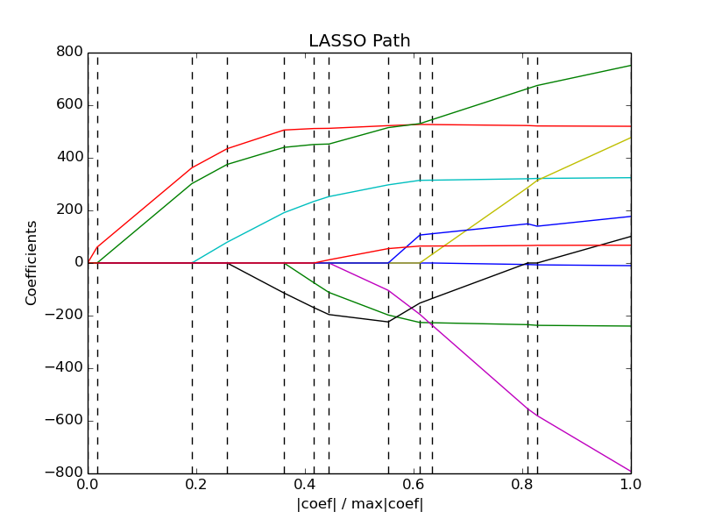
Regularization path
http://scikit-learn.org/stable/auto_examples/linear_model/plot_lasso_lars.html
See also:
Hastie et al 2004:
http://www.jmlr.org/papers/volume5/hastie04a/hastie04a.pdf
Efron 2004:
http://statweb.stanford.edu/~tibs/ftp/lars.pdf
Friedman et al 2010:
http://core.ac.uk/download/pdf/6287975.pdf

Slide 51
Summary
Heuristic HP search (wrapper-style) is computationally expensive, so we want to “push down” some HP to the learning machine.
But optimizing both parameters and HP with the training error is not a good idea because of:
Computational complexity: we loose convexity in parameter space.
Statistical complexity: we get infinite capacity.
Embedded methods solve a bi-level optimization problem by direct optimization of the HP with the CV error, e.g. by gradient descent.
Computational tricks for least square regression:
Leave-one-out error computed “cheaply” (virtual LOO).
Matrix factorization to vary the ridge value inexpensively.
Shrinkage (ǁwǁ_{q} regularizers) perform space dimensionality reduction.

Slide 52
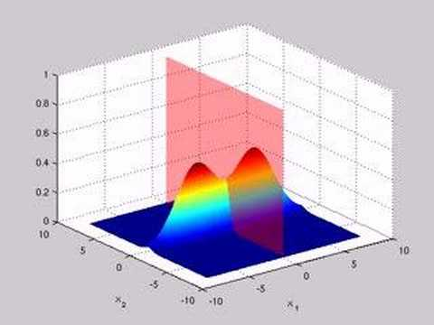
Come to my office hours… Wed 2:30-4:30 Soda 329
Next time:
Gaussian classifier

